Slide 1
Django Tutorial
Written by :Pooja Mishra

Slide 2
Content
Python Web Frameworks
What is Django ?
Why Use django
Who use Django
Django as an MVC Design Pattern
MVT architecture (Flow)
Django admin interface
Django files
Django support various Database
Advantage of Django
Simple Application
Conclusion

Slide 3
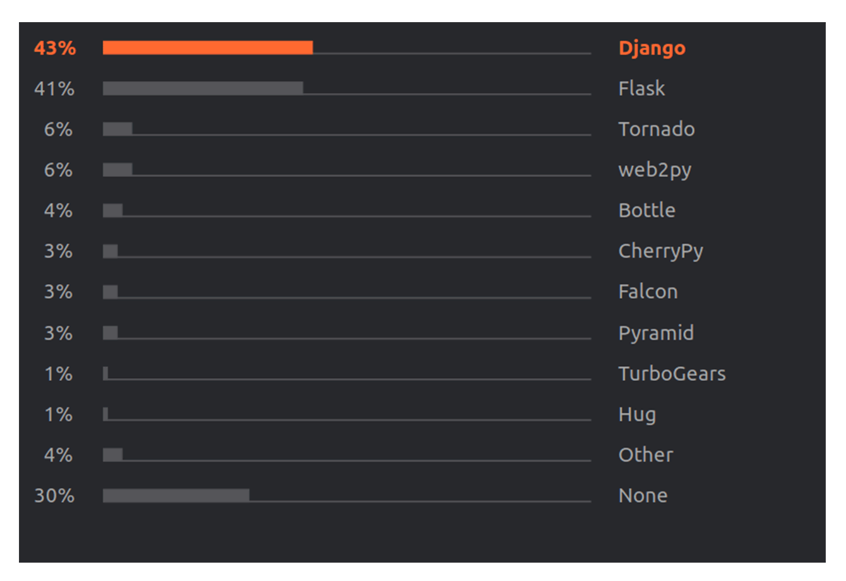
Python web frameworks

Slide 4
What is Django ?
Django is pronounced JANG-oh. The “D” is silent.
Django is a free and open source web application framework written in Python
Django is a high-level Python web framework that encourages rapid development and clean, pragmatic design.”
A framework is nothing more than a collection of modules that make development easier.
Django offers a big collection of modules which you can use in your own projects.

Slide 5
Cont..
Django helps eliminate repetitive tasks making the development process an easy and time saving experience.
Dynamic and database driven websites
Note − Django is a registered trademark of the Django Software Foundation, and is licensed under BSD License

Slide 6
Why use Django ?
It’s fast and simple
It’s secure
It suits any web application project
It’s well-established
Django follows the Don’t Repeat Yourself (DRY) principle

Slide 7
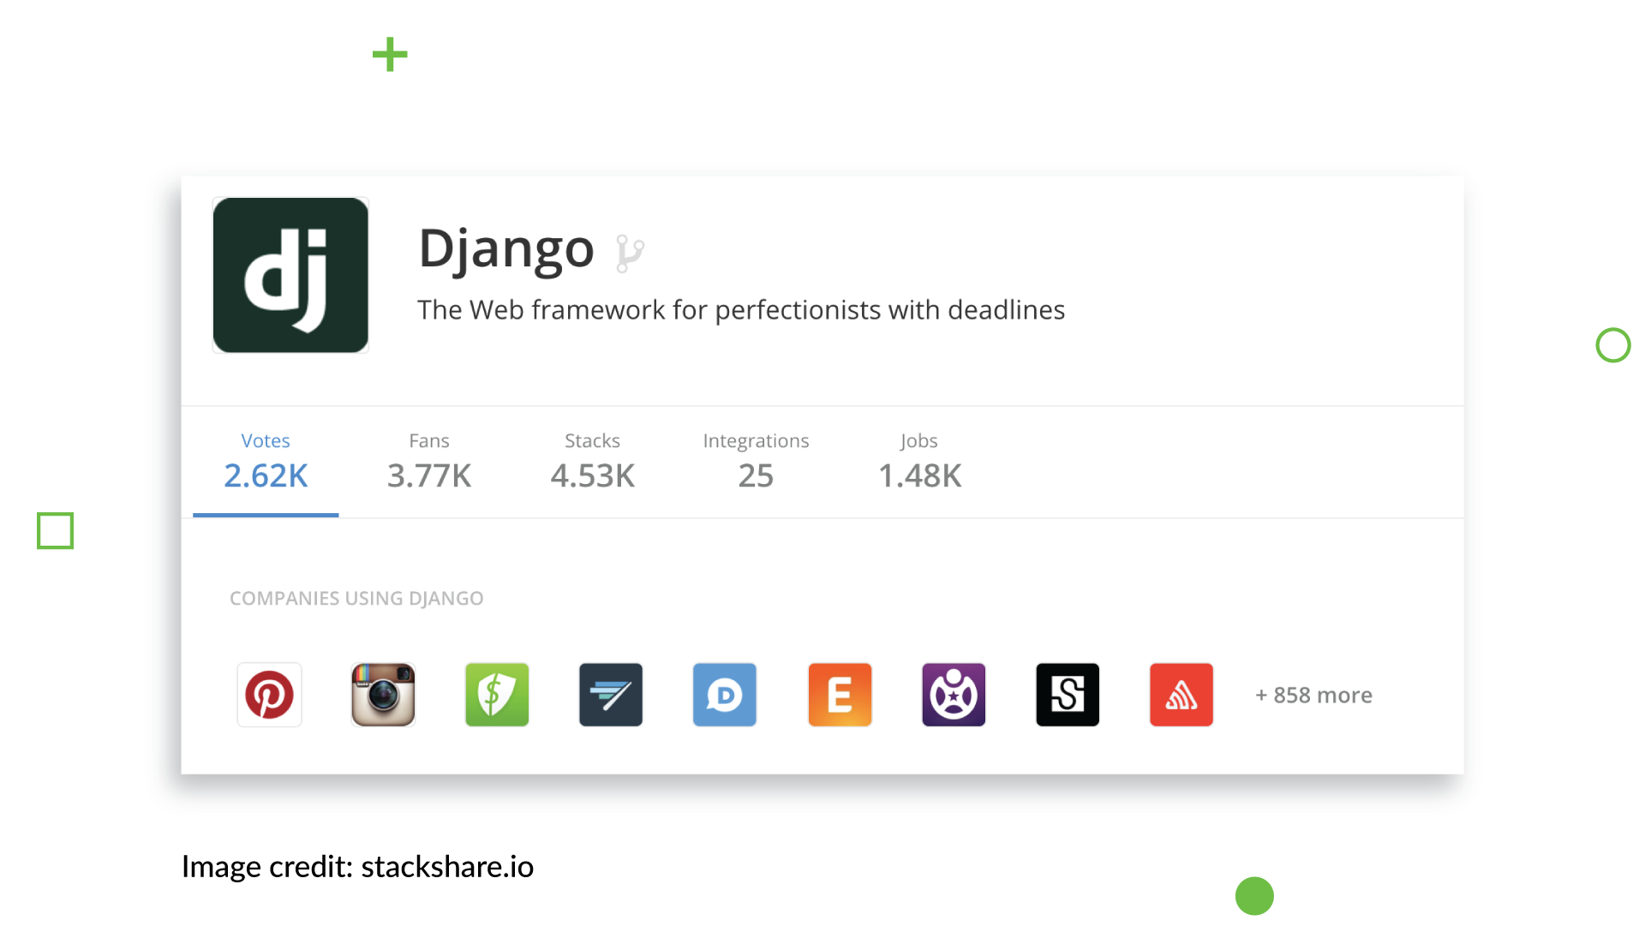
Who use Django?

Slide 8
Django as an MVC Design Pattern
MVT Architecture:
Models
Describes your data structure/database schema
Views
Controls What a user sees
Templates
How a user sees it
Controller ,
The Django Framework ,
URL parsing

Slide 9
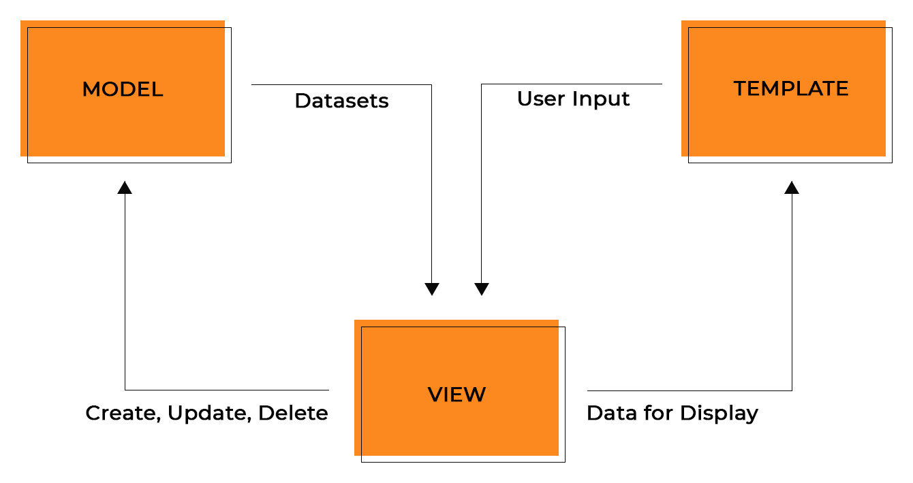
MVT architecture (Flow)

Slide 10
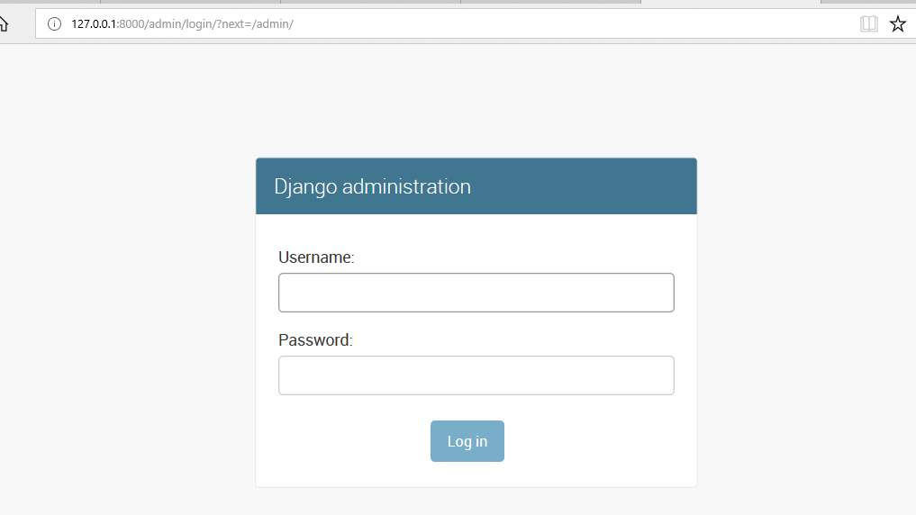
Django Admin interface

Slide 11
Cont..
It prompts for login details, if no login id is created before, then a new superuser can be created by using the command given below:
python manage.py createsuperuser

Slide 12
Cont..
Django have bydefault admin interface
To access this admin interface on browser write ‘/admin/’ at ‘localhost:8000/admin/’ and it shows the output as given below:

Slide 13
Admin interface
Django provides a default admin interface which can be used to perform create, read, update and delete operations on the model directly. It reads set of data that explain and gives information about data from the model, to provide an instant interface where the user can adjust conten
Activating and Using the Admin Interface The admin app(django.contrib.admin) is enabled by default and already added into the INSTALLED_APPS list present in the settings.py file.ts of the application .

Slide 14
Django Support Various Database
Django supports several major database engines and you can set up any of them based on your comfort.
MySQL (http://www.mysql.com/)
PostgreSQL (http://www.postgresql.org/)
SQLite 3 (http://www.sqlite.org/)
Oracle (http://www.oracle.com/)
MongoDb (https://django-mongodb-engine.readthedocs.org)
GoogleAppEngine Datastore (https://cloud.google.com/appengine/articles/django-nonrel)

Slide 15
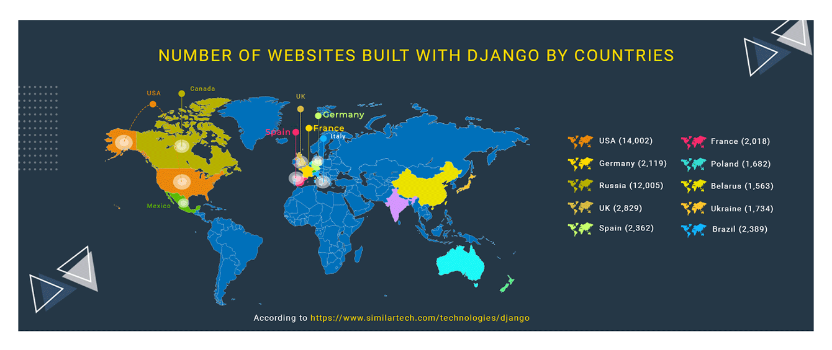

Slide 16
Django files
The outer mysite/ root directory is a container for your project. Its name doesn’t matter to Django; you can rename it to anything you like.
manage.py: A command-line utility that lets you interact with this Django project in various ways. You can read all the details about manage.py in django-admin and manage.py.
The inner mysite/ directory is the actual Python package for your project. Its name is the Python package name you’ll need to use to import anything inside it (e.g. mysite.urls).
mysite/__init__.py: An empty file that tells Python that this directory should be considered a Python package. If you’re a Python beginner, read more about packages in the official Python docs.

Slide 17
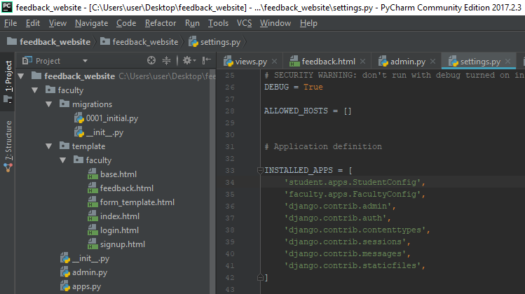
Django files

Slide 18
Conti..
mysite/settings.py: Settings/configuration for this Django project. Django settings will tell you all about how settings work.
mysite/urls.py: The URL declarations for this Django project; a “table of contents” of your Django-powered site. You can read more about URLs in URL dispatcher.
mysite/asgi.py: An entry-point for ASGI-compatible web servers to serve your project. See How to deploy with ASGI for more details.
mysite/wsgi.py: An entry-point for WSGI-compatible web servers to serve your project. See How to deploy with WSGI for more details.

Slide 19
View
A view function, or “view” for short, is simply a Python function that takes a web request and returns a web response. This response can be the HTML contents of a Web page, or a redirect, or a 404 error, or an XML document, or an image, etc. Example: You use view to create web pages, note that you need to associate a view to a URL to see it as a web page.
In Django, views have to be created in the app views.py file.

Slide 20
Url file
Now that we have a working view as explained in the previous chapters. We want to access that view via a URL. Django has his own way for URL mapping and it's done by editing your project url.py file (myproject/url.py). The url.py file looks like −

Slide 21
Template section
Django makes it possible to separate python and HTML, the python goes in views and HTML goes in templates. To link the two, Django relies on the render function and the Django Template language.
Django’s template engine offers a mini-language to define the user-facing layer of the application.
Displaying Variables
A variable looks like this: {{variable}}. The template replaces the variable by the variable sent by the view in the third parameter of the render function.

Slide 22
Model.py
A model is a class that represents table or collection in our DB, and where every attribute of the class is a field of the table or collection. Models are defined in the app/models.py (in our example: myapp/models.py)

Slide 23
Form.py
Creating forms in Django, is really similar to creating a model. Here again, we just need to inherit from Django class and the class attributes will be the form fields. Let's add a forms.py file in myapp folder to contain our app forms. We will create a login form.

Slide 24
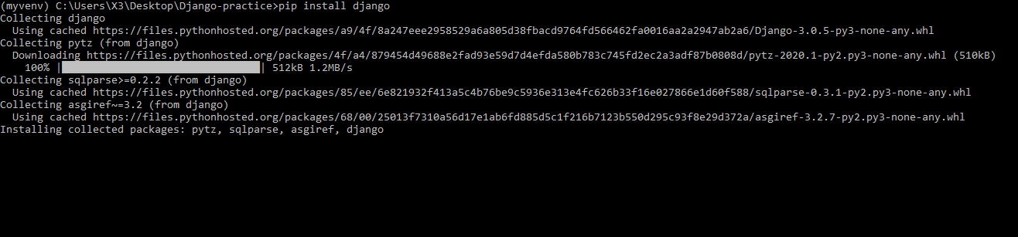
How to Download django

Slide 25

Creating project

Slide 26
Advantage
Object-Relational Mapping (ORM) Support − Django provides a bridge between the data model and the database engine, and supports a large set of database systems including MySQL, Oracle, Postgres, etc. Django also supports NoSQL database through Django-nonrel fork.
Multilingual Support − Django supports multilingual websites through its built-in internationalization system. So you can develop your website, which would support multiple languages.

Slide 27
Cont..
Framework Support − Django has built-in support for Ajax, RSS, Caching and various other frameworks.
Administration GUI − Django provides a nice ready-to-use user interface for administrative activities.
Development Environment − Django comes with a lightweight web server to facilitate end-to-end application development and testing.

Slide 28
Thank You

